Slide 1
Honours project
BSc mutaz al kathiri nu180290

Slide 2
Problem description
The problem that aviation professionals face is how to safely and efficiently navigate the challenges posed by the weather. This can be a complex and constantly changing problem, as the weather can vary significantly from one location to another and can change quickly over time.
One of the key challenges is that poor weather conditions, such as strong winds, thunderstorms, and turbulence, can make flying more difficult and can even be dangerous. Pilots and other aviation professionals need to be able to make informed decisions about whether to fly, what route to take, and what precautions to take in order to ensure the safety of the flight.

Slide 3
Project aim
To design and develop a weather forecast application that gathers weather information in real time and displays the information to help pilots in flight path and route plotting to reduce flight accidents and increase safety.

Slide 4
Objectives
A. To review and analyze current applications used in weather forecasts in aviation sector.
B. To study relevant aviation regulations relating to how weather can impact flight paths and how to choose which relevant data to display.
C. To study and understand about the tools required to implement the proposed system.
D. To design and develop a weather forecast application that will collect information from other systems and aid in aviation safety and flight path plotting.
E. To complete testing of the system using a wide array of weather instances around the world and to also compare the accuracy of data using other similar applications.

Slide 5
Scope
The project’s main scope is to create and enhance the methods used in weather forecasting application for aviation purposes. develop an easy-to-understand layout for pilots to use and gather weather information. The application should run on web based devices.

Slide 6
Literature Review
There were 5 papers that were reviewed all that were similar in nature to the proposed project.
A Cloud-Based Real-Time Weather Forecasting Application (Beeharry, Fowdur and Sunglee, 2019).
Application Model for Travel Recommendations Based on Android. (Wahdiniwaty et al., 2019).
Weather Forecasting Application Using Web-Based Model-View-Whatever Framework (Hernandez, 2021).
REPORTS THE CURRENT WEATHER CONDITIONS ON CELL PHONES USING WEB SERVICES (Zhao and Fan, 2010).
System design to use weather forecast & current condition information on travel route with KNN and graphical data on Android application (Ginardi et al., 2017).
Evaluation
It gathers and reviews their design methodologies and discusses the results obtained. While investigating on which components and software techniques used to complete their projects. It also compares between different papers methodologies and techniques, with some having faster response times due to cloud-based databases. This provided a better understanding into what development of the application will entail.

Slide 7
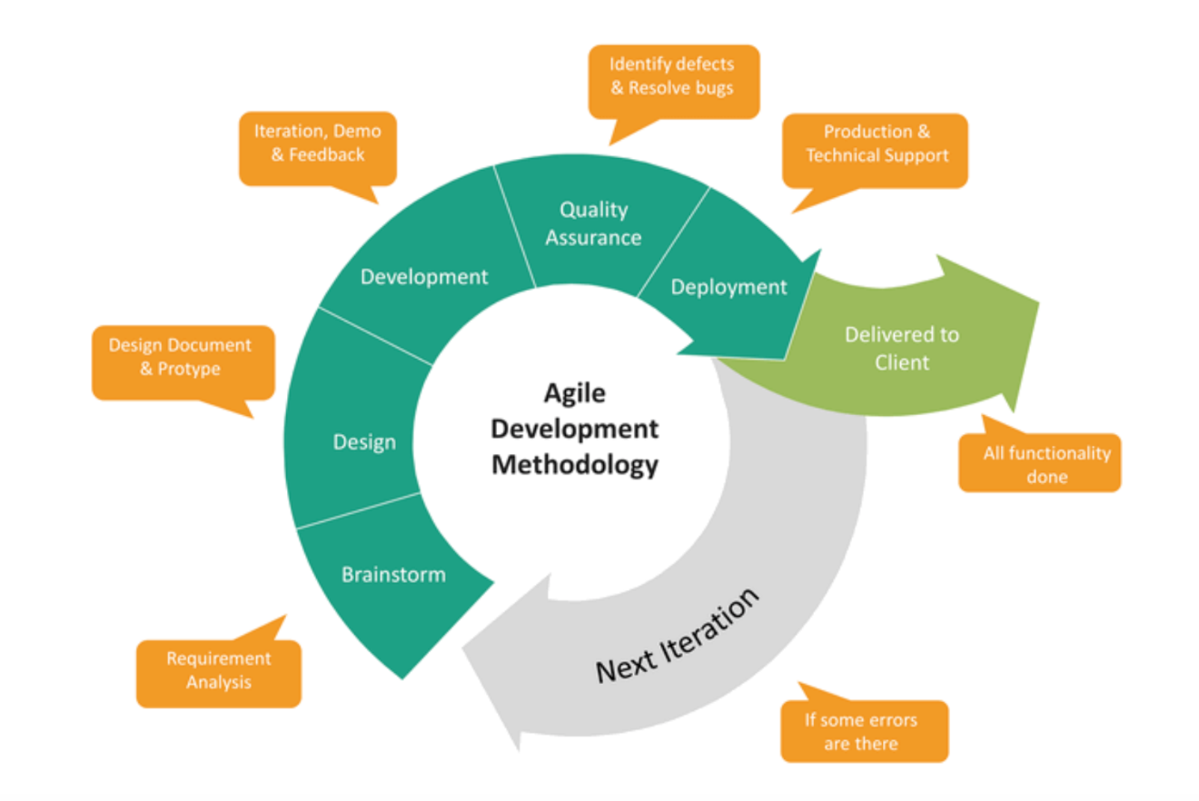
METHODOLOGY
The Aviation Weather System will be developed using the agile model. This approach to software development is iterative and incremental, and it emphasizes the delivery of small, working increments of the software on a regular basis. The agile model is well-suited for this project because the requirements may change depending on the API that is connected.
Agile methodology (orionadvisortech.com, n.d.)

Slide 8
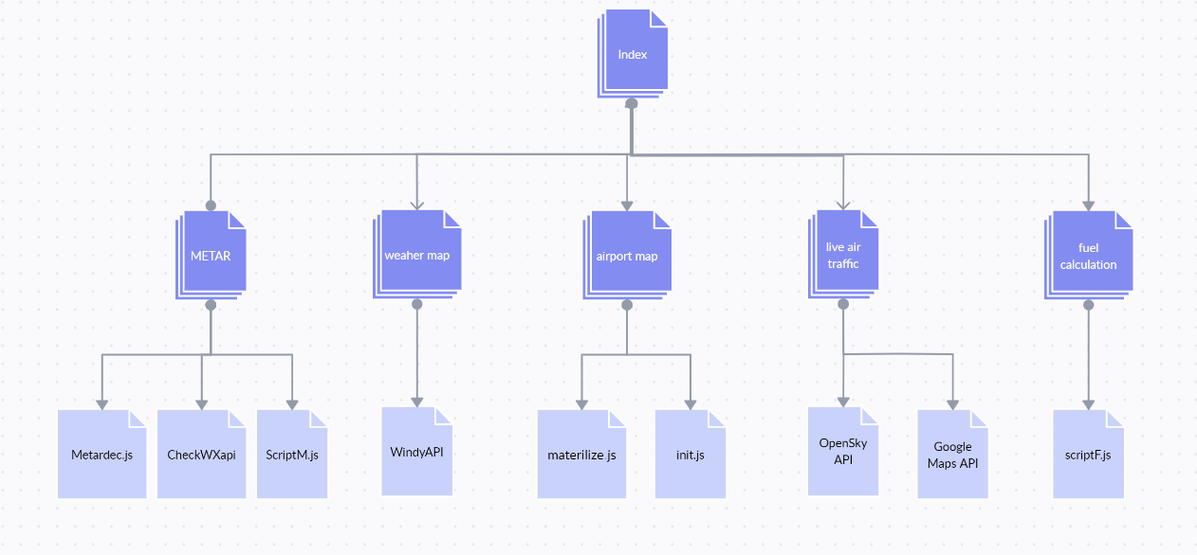
METHODOLOGY
Site map

Slide 9
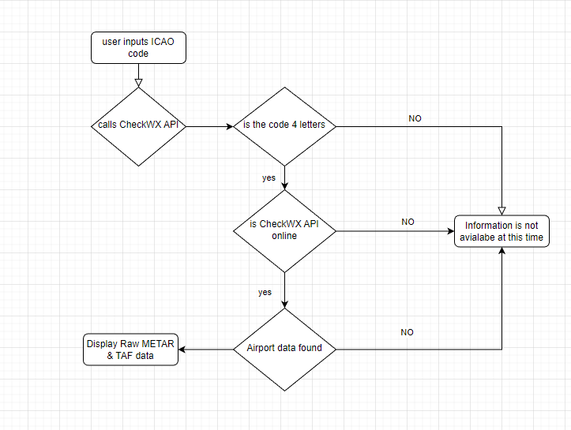
Flowchart

Slide 10
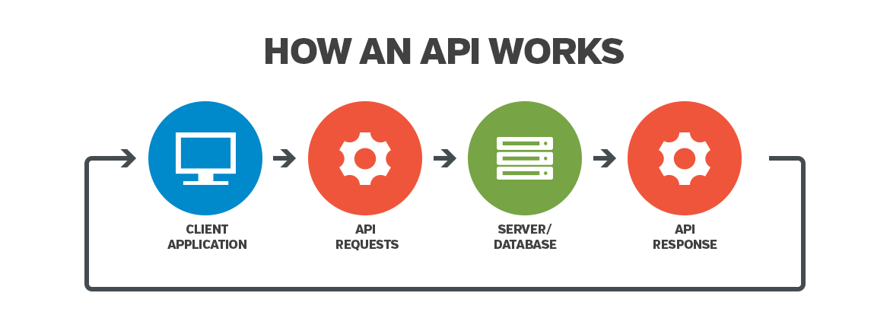
Implementation
To link the HTML page with the API’s it needed javascript to execute a fetch request. A fetch request is a method where it allowed the HTML page to request data from a service such CheckWX API.
Software Requirements
• Visual studio code
• XAMPP
• Google maps API key
• CheckWXapi
• Windy API
• OpenSky API
• HTML
• CSS
• JavaScript
• PHP script
• GitHub
• Windows operating system
API explained (Bridget, 2021)

Slide 11
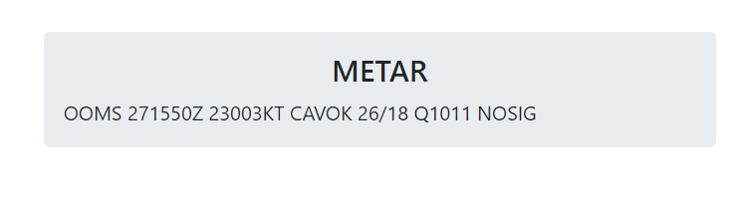
Implementation
CheckWXapi provides raw METAR data most users will not be able to read this information. To counter this the project will use JavaScript to allow for a method to decipher this raw data.
The user will input the ICAO code of any airport and the data will be presented.
how metar data appears raw (self,2022)

Slide 12
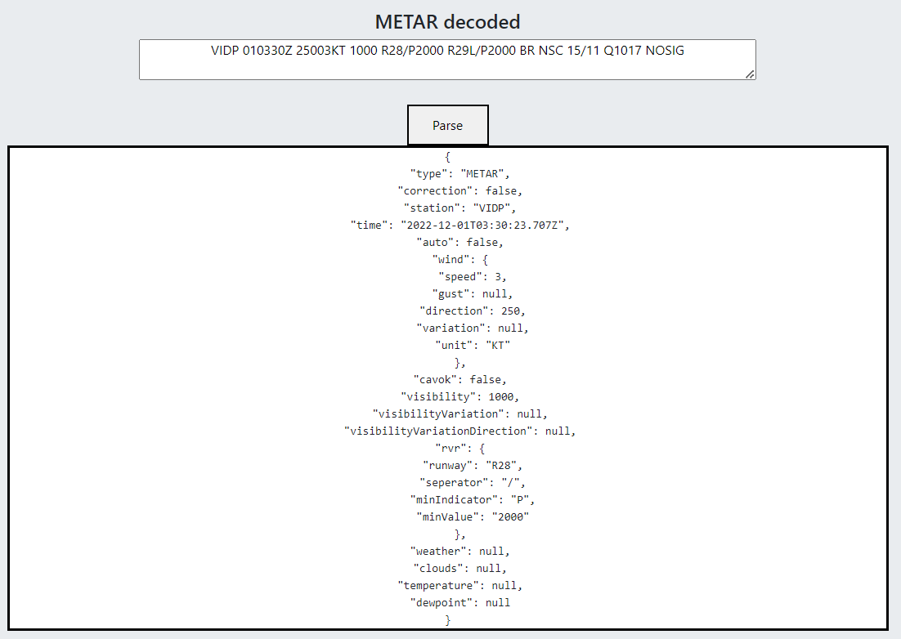
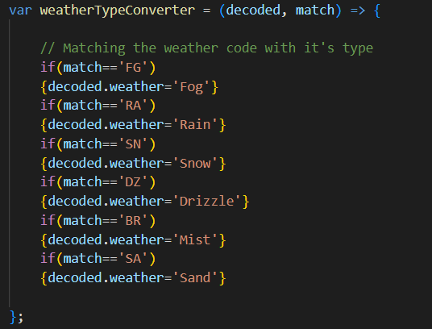
Decode METAR data

Slide 13
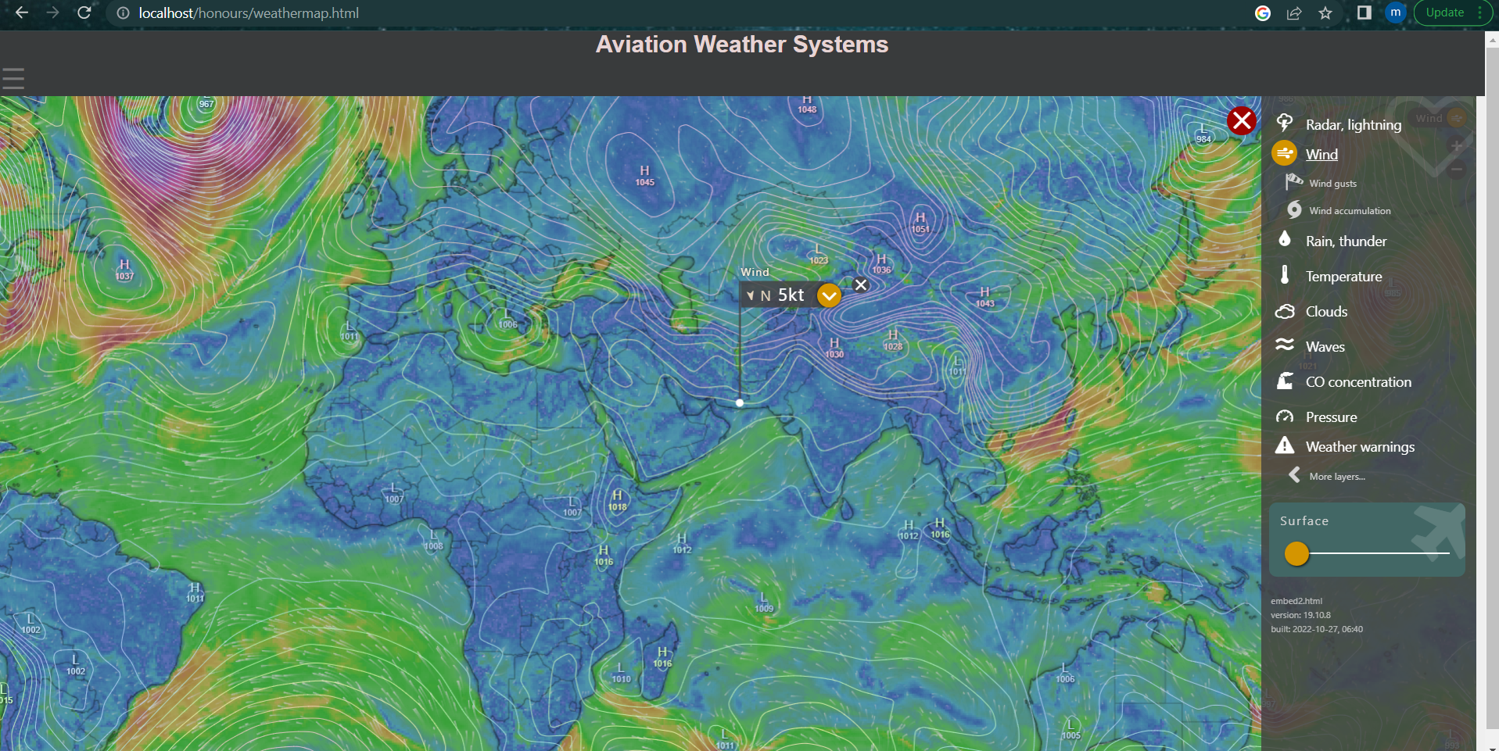
Weather map
The project used Windy API to display a live weather map that allows the user to check weather data of any place around the world

Slide 14
Testing
The METAR page tests will use 5 separate airports and gather their data while also comparing data gathered from other applications. It will test two aspects of the page the decoder and the CheckWX API linked fetch request. For one of the tests, it will rival the results against METARreader.com.

Slide 15
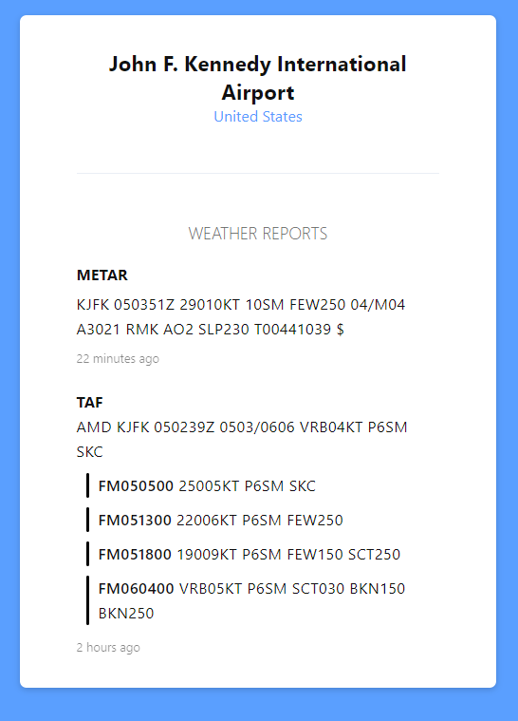
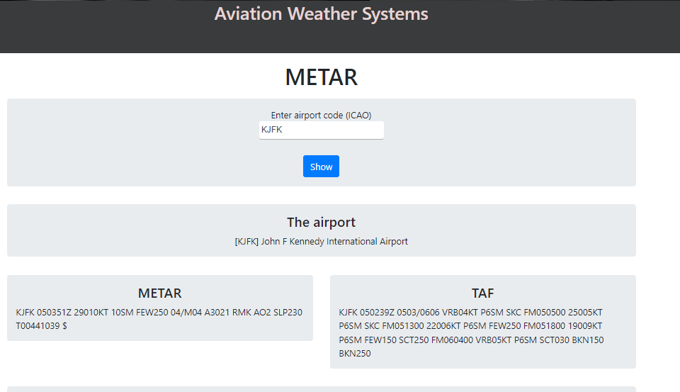
Raw METAR KJFK airport

Slide 16
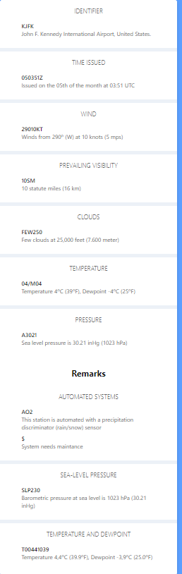
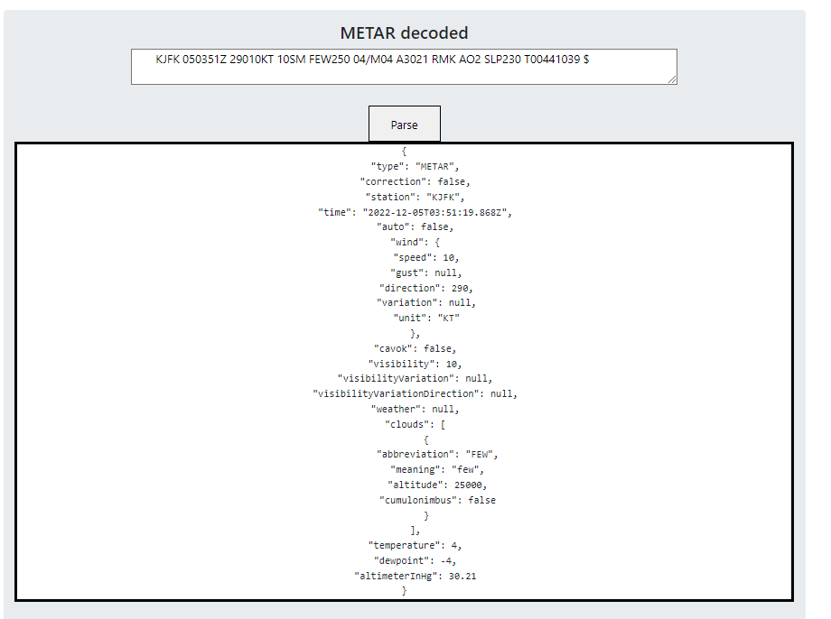
Decoded METAR KJFK test

Slide 17
Differences between both systems
The METAR decoder function of the application works well providing and decoding the raw data accurately. The only visible difference is the METARreader.com decoded data provides the temperature in decimals while the application provided with no decimals.
the aviation weather system provides the status of CAVOK (cloud and visibility OK) while the other application does not.

Slide 18
Evaluation of the results
The Aviation Weather System has a variety of functions all created to help pilots. While the main aim was to provide weather data other functions were added to help expand on aiding flight safety. features such as fuel calculation for aircrafts using both IFR and VFR rules, an airport map that has a big number of airports with data such as ICAO codes and descriptions, a functioning weather map using Windy API that can show cloud levels, wind and visibility. A live air traffic page that uses OpenSky API to show the huge number of flights.
The focus of the project is on the METAR page from the prior tests METAR and TAF data is provided accurately. While the decoder function works as intended.
The project achieved its objectives but some of the added pages lack some foundation to them such as the fuel calculation page

Slide 19
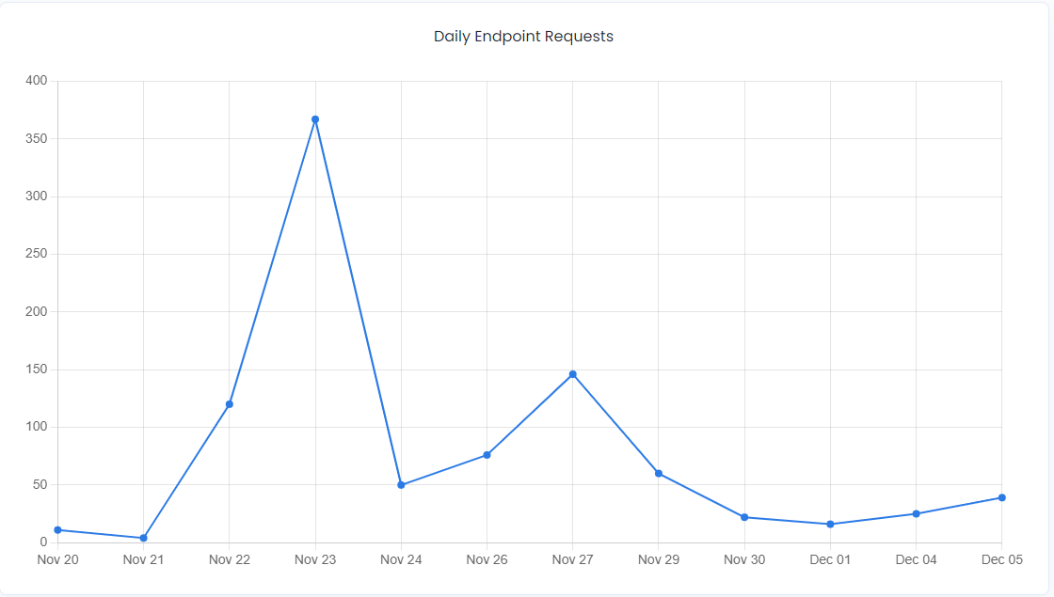
Evaluation of the results
CheckWX API calls (self,2022)

Slide 20
Conclusion and future works
it can be observed that the Aviation Weather system achieved the discussed objectives. It gathers weather data from airports all across the planet while using an internationally used aviation METAR and displays it immediately. Providing accurate and detailed weather data for aviation use.

Slide 21
Conclusion and future works
the fuel calculation page can calculate how much fuel that a certain aircraft will consume depending on distance, cruising speed and other variables. It follows both IFR and VFR rules. But it is lacking as it does not include weight as a variable and needs to be improved.
The METAR page should automatically decode the data and present it but it requires the user to copy and paste to decode the METAR data.
More airports can be added in the airport map page it will requires google tag manager or finding another alternative.

Slide 22
Refrences
Beeharry, Y., Fowdur, T.P. and Sunglee, J.A. (2019). A Cloud-Based Real-Time Weather Forecasting Application. [online] IEEE Xplore. doi:10.1109/℡SIKS46999.2019.9002327.
Box, D., Ehnebuske, D. and Kakivaya, G. (2000). Simple object access protocol (SOAP) 1.1. [online] Available at: https://www.researchgate.net/profile/Satish-Thatte/publication/239553871_Simple_object_access_protocol_SOAP_11/links/54489e4e0cf2f14fb8142a59/Simple-object-access-protocol-SOAP-11.pdf.
Bucanek, J. (2009). Learn Objective-C for Java Developers. [online] Google Books, Apress, pp.353–354. Available at: https://books.google.com.om/books?id=zaSzZKYoBAAC&printsec=frontcover&dq=model+view+controller&hl=en&sa=X&ved=2ahUKEwjfxefvxf32AhVYNuwKHci3CrAQuwV6BAgDEAc#v=onepage&q=model%20view%20controller&f=false [Accessed 5 Apr. 2022].
Cerami, E. (2002). Web Services Essentials: Distributed Applications with XML-RPC, SOAP, UDDI & WSDL. [online] Google Books. ‘O’Reilly Media, Inc.’ Available at: https://books.google.com.om/books?hl=en&lr=&id=tIM4DwAAQBAJ&oi=fnd&pg=PR5&dq=WSDL&ots=41DEnf5C59&sig=t91115-d7QfZSPKrWi1-BIZuwHA&redir_esc=y#v=onepage&q=WSDL&f=false [Accessed 24 May 2022].
Chen, Y. (2020). COVID‐19 Pandemic Imperils Weather Forecast. Geophysical Research Letters, 47(15). doi:10.1029/2020gl088613.
Fowdur, T.P., Beeharry, Y., Hurbungs, V., Bassoo, V., Ramnarain-Seetohul, V. and Lun, E.C.M. (2018). Performance analysis and implementation of an adaptive real-time weather forecasting system. Internet of Things, 3-4, pp.12–33. doi:10.1016/j.iot.2018.09.002.
Ginardi, R.V.H., Munif, A., Nurul, K.W., Rosyidi, A., Khoiruddin, A. and Perdana, R. (2017). System design to use weather forecast amp; current condition information on travel route with KNN and graphical data on Android application. [online] IEEE Xplore. doi:10.1109/ICTS.2017.8265685.
Google.com. (2022). Avertissement de redirection. [online] Available at: https://www.google.com/url?sa=i&url=https%3A%2F%2Fwww.scnsoft.com%2Fblog%2Fnosql-databases&psig=AOvVaw3ThRLla6Fuv4n3JZwo2wzc&ust=1653424024094000&source=images&cd=vfe&ved=0CAwQjRxqFwoTCND85s-69vcCFQAAAAAdAAAAABAP [Accessed 23 May 2022].
Green, B. and Seshadri, S. (2013). AngularJS. [online] Google Books. ‘O’Reilly Media, Inc.’ Available at: https://books.google.com.om/books?hl=en&lr=&id=eNExy_X1YYcC&oi=fnd&pg=PR2&dq=angularjs+framework&ots=wB3hD1HdT8&sig=f5irJQd9DqN0f2NrLxu3ssdxs0c&redir_esc=y#v=onepage&q=angularjs%20framework&f=false [Accessed 5 Apr. 2022].
Gultepe, I., Sharman, R., Williams, P.D., Zhou, B., Ellrod, G., Minnis, P., Trier, S., Griffin, S., Yum, Seong.S., Gharabaghi, B., Feltz, W., Temimi, M., Pu, Z., Storer, L.N., Kneringer, P., Weston, M.J., Chuang, H., Thobois, L., Dimri, A.P. and Dietz, S.J. (2019). A Review of High Impact Weather for Aviation Meteorology. Pure and Applied Geophysics, 176(5), pp.1869–1921. doi:10.1007/s00024-019-02168-6.
Hernandez, R. (2021). The Model View Controller Pattern – MVC Architecture and Frameworks Explained. [online] freeCodeCamp.org. Available at: https://www.freecodecamp.org/news/the-model-view-controller-pattern-mvc-architecture-and-frameworks-explained/.
Hussain, M.M., Avci, B., Trajcevski, G. and Scheuermann, P. (2016). Incorporating Weather Updates for Public Transportation Users of Recommendation Systems. [online] IEEE Xplore. doi:10.1109/MDM.2016.57.
Jadhav, M. (2015). Single Page Application using AngularJS. [online] citeseerx.ist.psu.edu. Available at: https://citeseerx.ist.psu.edu/viewdoc/download?doi=10.1.1.736.4771&rep=rep1&type=pdf.
Kolokolov, Y., Monovskaya, A., Volkov, V. and Frolov, A. (2017a). Intelligent integration of open-access weather-climate data on local urban areas. [online] IEEE Xplore. doi:10.1109/IDAACS.2017.8095124.
Kolokolov, Y., Monovskaya, A., Volkov, V. and Frolov, A. (2017b). Intelligent integration of open-access weather-climate data on local urban areas. [online] IEEE Xplore. doi:10.1109/IDAACS.2017.8095124.

